Slide 1
Deploy Swiggy Application By Using Jenkins && Docker
Created By
Niranjan
Start:20/02/2025
End: 21/02/2025

Slide 2
What is Jenkins?
Jenkins is a tool that is used for automation. It is mainly an open-source server that allows all the developers to build, test and deploy software. It is written in Java and runs on java only. By using Jenkins we can make a continuous integration of projects(jobs) or end-to-endpoint automation.

Slide 3


Slide 4
Why Organizations use Jenkins?
Jenkins facilitates the automation of several stages of the software development lifecycle, including application development, testing, and deployment. Operating within servlet containers like Apache Tomcat, the technology is server-based.Continuous delivery (CD) and integration (CI) pipelines can be created and managed with Jenkins. The development, testing, and deployment of software applications are automated using CI/CD pipelines. You will be able to release software more regularly and with fewer problems if you do this.
jenkins is flexible.
You can add the n no.of plugins you want to add to the jenkins.
You can automate the proceses of CI/CD pipelines of all the projects.

Slide 5
What is Jenkins CI/CD Pipeline?
Jenkins CI/CD stands for Continuous Integration / Continuous Deployment first let us try to understand what is a pipeline. In computing, a pipeline is a set of stages or processes linked together to form a processing system. Each stage in the pipeline takes an input, processes it in accordance with a set of rules, and then sends the outputs to the stage that follows. Frequently, the pipeline’s overall output is its final step’s output. like the procedures outlined below
Test code
Build Application
Push Repository
Deploy to Server

Slide 6
What is Jenkins Continuous Integration (CI)?
Jenkins Continuous integration means whenever new code is committed to remote repositories like GitHub, GitLab, etc. Continuous Integration (CI) will continuously build, tested, and merged into a shared repository.
Benefits of Continuous Integration (CI)
We can maintain the reports of the projects
Deployments can be made within the given time
Bugs can be found quickly.

Slide 7
What is Jenkins Continuous Deployment/Delivery (CD)?
Continuous Deployment
Continuous Deployment means automating the further stages of the pipeline automatically or manually deploying the application/code to different environments like Dev, Test, and Production. Automating the build is the main component of Continuous Integration and Continuous Deployment.
Continuous Delivery
Each and every build that passed all automated tests and was able to be fully automated and delivered into production only required one click of human intervention is called Continuous Delivery.

Slide 8
What is Jenkins Pipeline?
DevOps professionals mostly work with pipelines because pipelines can automate the processes like building, testing, and deploying the application. Doing manually by UI takes lots of time and effort which will affect productivity. With the help of Continuous Integration / Continuous Deployment (CI/CD) Pipeline scripts we can automate the whole process which will increase productivity and save lots of time for the organization and can deliver quality applications to the end users

Slide 9
Advantages && Disadvantages of Jenkins
advantages
disadvantages
Easy to install: Easy to install and upgrade on many operating systems
User-friendly: Has a simple and user-friendly interface
Extensible: Supports distributed builds across different computers
Highly scalable: Can scale up to meet the needs of growing organizations
Auto-scaling: Can automatically scale up to meet the needs of growing organizations
Large plugin library: Has a large library of plugins that can be customized to meet specific needs
Strong community support: Has a large community of users and developers who contribute to its development
Lack of analytics: Lacks end-to-end analytics, which can contribute to a lack of overall tracking
Requires deployment: Requires deployment on a server

Slide 10
What is Docker?
Docker is an open-source containerization platform by which you can pack your application and all its dependencies into a standardized unit called a container. Containers are light in weight which makes them portable and they are isolated from the underlying infrastructure and from each other container. You can run the docker image as a docker container in any machine where docker is installed without depending on the operating system.

Slide 11
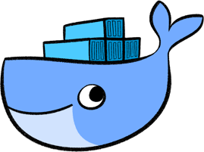

Slide 12
Why Docker is popular?
Docker gained its popularity due to its impact on the software development and deployment. The following are the some of the main reasons for docker becoming popular:
Portability: Docker facilitates the developers in packaging their applications with all dependencies into a single lightweight containers. It facilities in ensuring the consistent performance across the different computing environments.
Reproducibility: Through encapsulating the applications with their dependencies within a container it ensures in software setups remaining consistent across the development, testing and production environments.
Efficiency: Docker through its container based architecture it optimizes the resource utilization. It allows the developers to run the multiple isolated applications on a single host system.
Scalability: Docker’s scalability features facilitated the developers in making easier of their applications handling at time of workloads increment.

Slide 13
Key Components of Docker
Docker Engine: It is a core part of docker, that handles the creation and management of containers.
Docker Image: It is a read-only template that is used for creating containers, containing the application code and dependencies.
Docker Hub: It is a cloud based repository that is used for finding and sharing the container images.
Dockerfile: It is a script that containing instructions to build a docker image.
Docker Registry : It is a storage distribution system for docker images, where you can store the images in both public and private modes.

Slide 14
Use Cases of Docker
Continuous Integration and Continuous Deployment (CI/CD) : It helps in streamlining and automating the software delivery process with ensuring faster and more reliable releases.
Microservices Architecture: It facilitates the development, deployment, and management of microservices with enabling independent scaling and maintenance.
Development Environment Consistency: It will ensures with consistent development, testing, and production environments, reducing “it works on my machine” issues.
Multi-Cloud and Hybrid Cloud Deployments: It helps in simplifying the application deployment across various cloud platforms, enhancing flexibility and reducing vendor lock-in.

Slide 15
Docker Commands
Docker Run: It used for launching the containers from images, with specifying the runtime options and commands.
Docker Pull: It fetches the container images from the container registry like Docker Hub to the local machine.
Docker Ps : It helps in displaying the running containers along with their important information like container ID, image used and status.
Docker Stop : It helps in halting the running containers gracefully shutting down the processes within them.
Docker Start: It helps in restarting the stopped containers, resuming their operations from the previous state.
Docker Login: It helps to login in to the docker registry enabling the access to private repositories.

Slide 16
Advantages && Disadvantages of Docker
Advantages
Disadvantages
1. It is light weight because it does not require any resource pre-allocation (RAM). Whenever it needs resources it acquires them from host OS. It is of less cost.
2.Continuous integration efficiency – Docker enables you to build a container image and use that same image across every step of the deployment process.
3. It can run on physical hardware, virtual hardware and on cloud.
4..You can re-use the image.
5. It takes very less time to create.
1.Docker is not good for application that requires rich GUI.(Graphical User Interface)
2. It is difficult to manage large amount of containers.
3.Docker does not provide cross-platform compatibility means if an application is designed to run in a Docker container on windows, then it cannot run on Linux Docker container.
4.Docker is suitable when development OS and testing OS are same.
5.It does not provide any solution for data backup and recovery.

Slide 17
Sonar Analysis
SonarQube is a code analysis tool that is used to find a number of bugs, duplications, security vulnerabilities, and many more. On the other hand, Jenkins is an open-source automation tool used to automate the build, test, and deploy stages of a software development lifecycle.

Slide 18
Key Points
1)Sonar is a code -quality testing Tool to automatically scan and analyze source code within a continuous integration (CI) pipeline, identifying potential code quality issues, security vulnerabilities.
2)Sonar uses static code analysis techniques to scan code without actually executing it, detecting issues like syntax errors, potential bugs, and code style violations across various programming languages.
3)A critical feature where predefined quality thresholds can be set to automatically fail a build or deployment if the code quality falls below the acceptable level, preventing poor quality code from reaching production.
4)Organizations can customize Sonar rules based on their specific coding standards and project requirements to tailor the analysis to their needs.
5)Seamless integration with CI/CD tools allows for automatic Sonar analysis on every code commit, providing immediate feedback to developers during the development process.

Slide 19
6)Sonar allows tracking code quality metrics over time, enabling teams to identify areas where code quality is improving or declining, helping to identify potential regressions.
7)Proactive identification and correction of code issues leads to more reliable and robust software.
8)Catching potential problems early in the development lifecycle minimizes the cost of fixing bugs later.
9)By streamlining code quality checks, teams can deliver software updates more quickly.
10)Sonar reports provide a shared view of code quality across the development team, facilitating better communication and collaboration.

Slide 20
what is SonarQube?
SonarQube is an open-source platform that analyzes code quality to help developers improve code reliability and security. It can be used to detect bugs, vulnerabilities, and code smells.
How it works :
Analyzes code for over 30 programming languages, frameworks, and IaC platforms
Integrates with DevOps platforms like GitHub, GitLab, Azure, and Bitbucket
Runs static and dynamic analyses of source code
Provides actionable insights to improve code quality.

Slide 21


Slide 22
Benefits
Improves code quality and maintainability
Helps deliver more reliable products to users
Helps adhere to industry best practices
Helps write cleaner, more efficient code

Slide 23
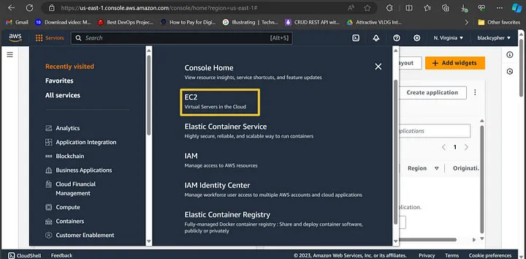
Step 1 — Create an EC2 instance

Slide 24
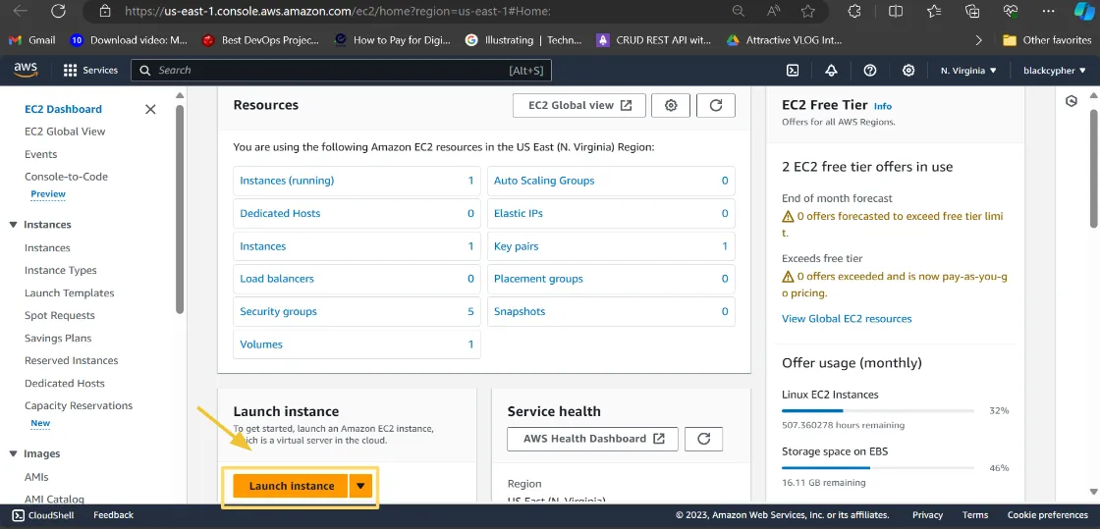
Step 2. Click “Launch Instance” to begin the process of creating an EC2 instance.

Slide 25
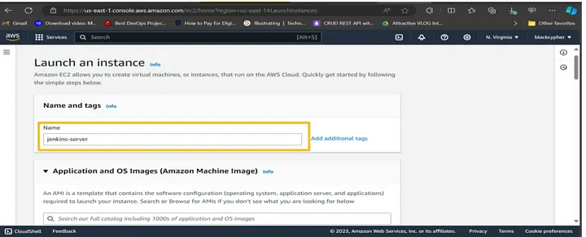
Step 3:Give the instance Name (should be unique and small letters only)

Slide 26
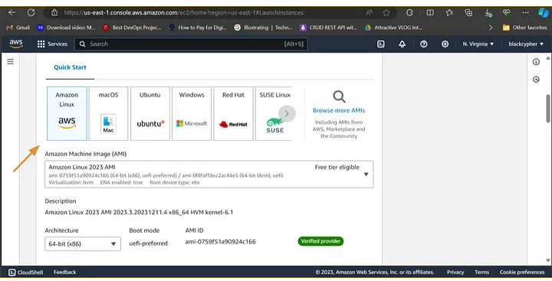
Step 4: Choose the Amazon machine image Select Ubuntu As Shown Below.

Slide 27
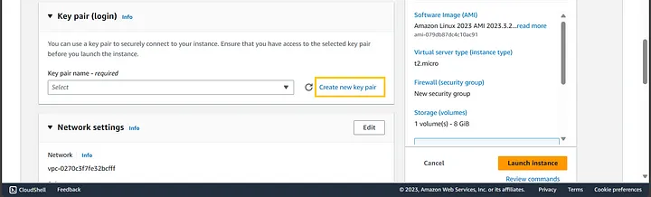
Step 5: In the configure key pair step, you have the option of selecting an existing key pair or creating a new one as shown below:

Slide 28
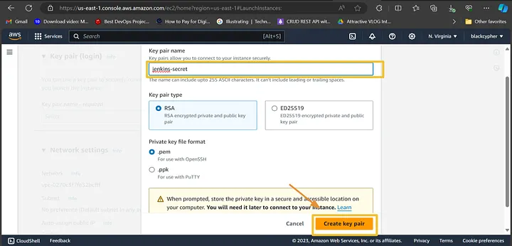
After giving name click create key pair.

Slide 29
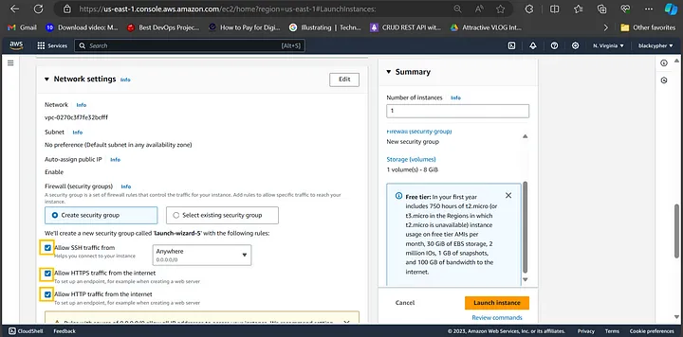
Step 6: In the network settings, you can select an existing security group or create a new one as shown below

Slide 30
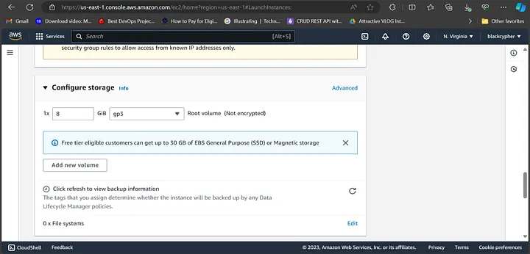
Step7:Configure storage should be 30 Gib storage.

Slide 31
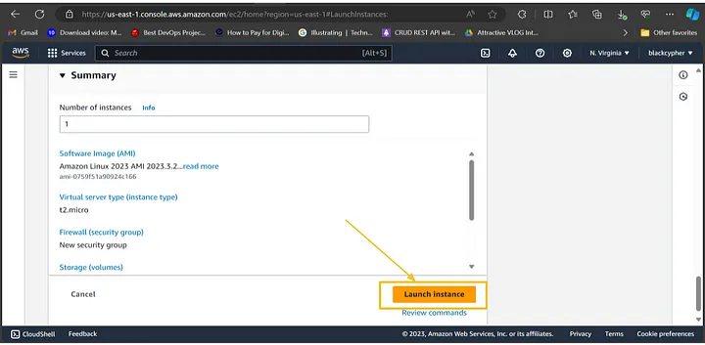
Step 8: In the summary you can review the setup configuration. Then, click launch instance to start an EC2 instance.

Slide 32
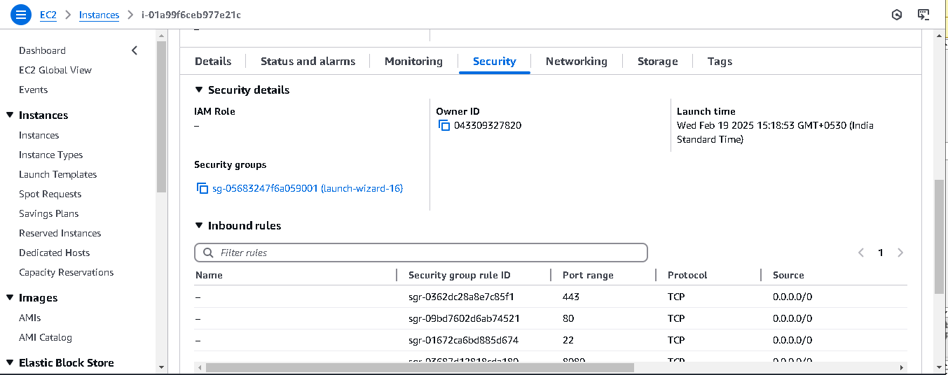
Step 9: After launch the instance click on instance checkbox scroll down go to security and click security groups and go to Edit inbound rules. Add rules give port numbers (Jenkins:8080,8090, give anyone ) (Swiggy:3000),(Sonarqube:9000)

Slide 33
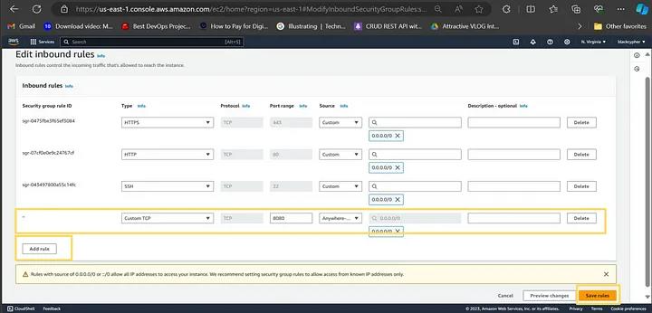
Step 10:After adding Rules click Save Rules

Slide 34
Jenkins Installation Path
sudo wget -O /usr/share/keyrings/jenkins-keyring.asc \ https://pkg.jenkins.io/debian-stable/jenkins.io-2023.key
echo "deb [signed-by=/usr/share/keyrings/jenkins-keyring.asc]" \ https://pkg.jenkins.io/debian-stable binary/ | sudo tee \ /etc/apt/sources.list.d/jenkins.list > /dev/null
sudo apt-get update
sudo apt-get install fontconfig openjdk-17-jre
sudo apt-get install jenkins
sudo systemctl start jenkins sudo systemctl enable jenkins sudo systemctl status jenkins

Slide 35
Maven Installation Path
sudo systemctl daemon-reload sudo systemctl restart jenkins.service sudo systemctl status jenkins.service----->once you can stop the instance again start the same instance By using this Commands
sudo apt install maven -y mvn –versión---> For checking Maven version

Slide 36
Docker Installation Path
sudo apt-get update sudo apt-get install docker.io -y sudo usermod -aG docker $USER newgrp docker sudo chmod 777 /var/run/docker.sock
docker run -d --name sonar -p 9000:9000 sonarqube:lts-community
docker run -it --name sonar -p 9000:9000 sonarqube:lts-community
-d--->Detached Mode(BackEnd Process)
-it--->Iteractive Mode(FrontEnd Process)
After Applying This Commands copy Public Ip and take 2 New Tabs Paste give port numbers you have given in Security Rules

Slide 37
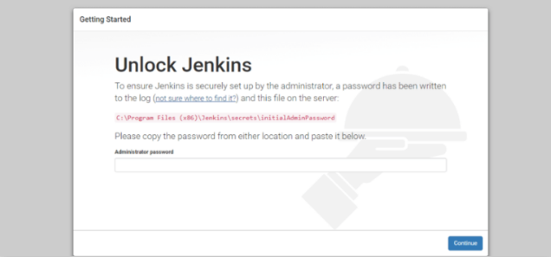
Step 11:Unlock Jenkins page will appear which requires an administrator password by using sudo cat copy the Red letters as shown below.

Slide 38
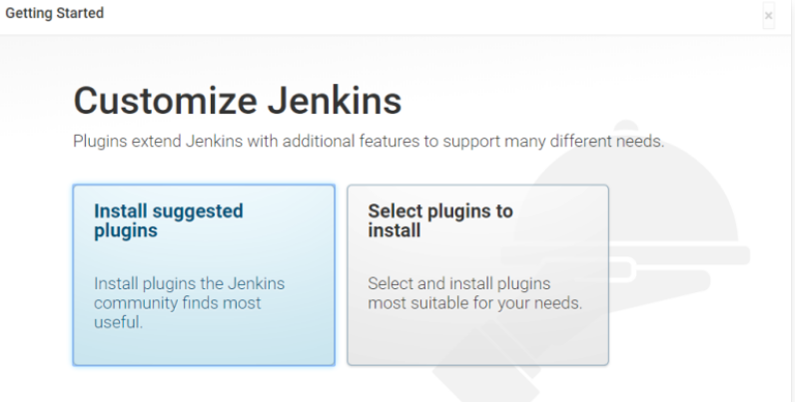
Step 12:After unlocking Jenkins, the Customize Jenkins page appears. Select Install suggested plugins

Slide 39
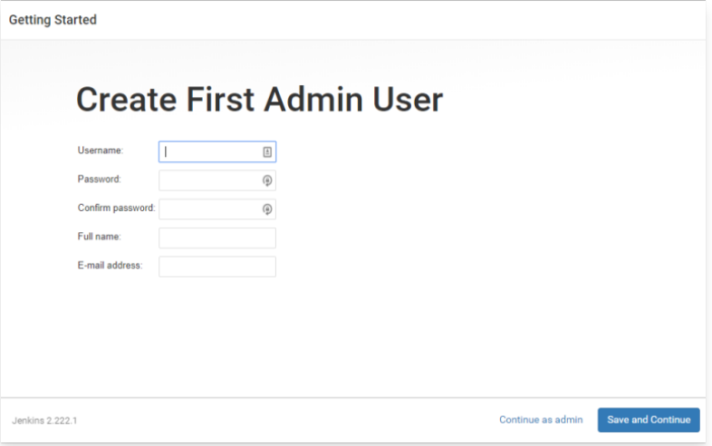
Step 13:After plugins are install Create First Admin User page appears. Enter details and click on Save button.

Slide 40
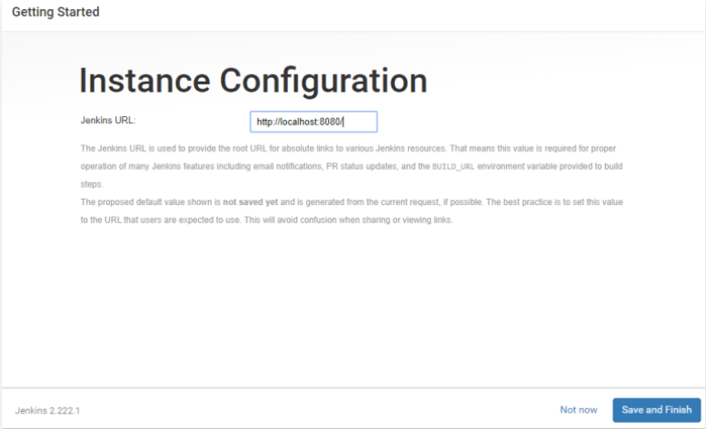
Step 14:Instance Configuration page appears,you don’t change Jenkins URL then click on Save and Finish button.

Slide 41
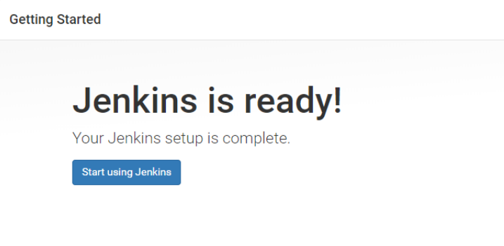
Step 15:Jenkins is ready page appears. Click on Start using Jenkins button.

Slide 42
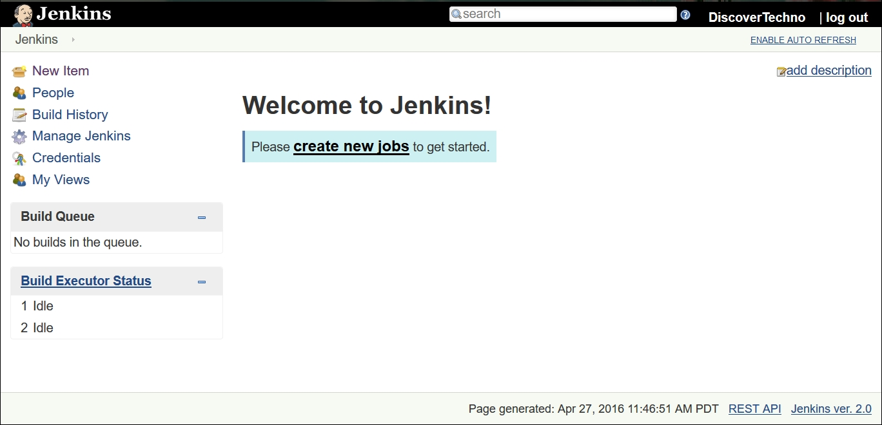
Step 16:Jenkins Dashboard Display

Slide 43
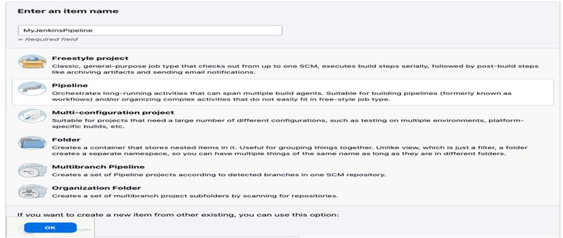
Step 17:Create Jenkins Pipeline

Slide 44
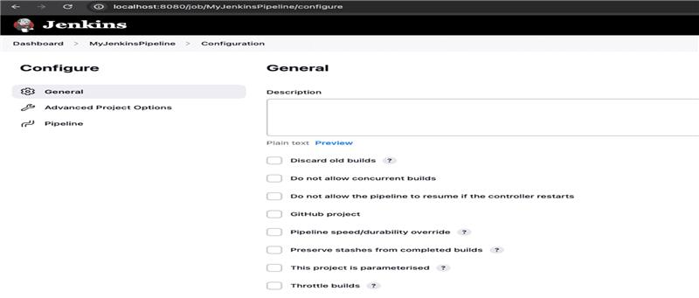
Step 18:Configure Pipeline Options

Slide 45
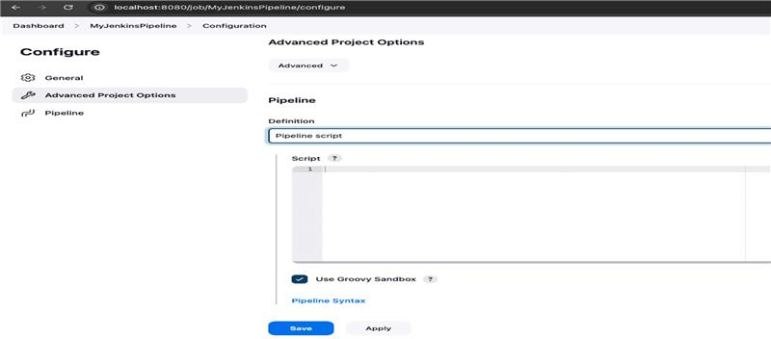
Step 19:Create Pipeline Script

Slide 46
pipeline { agent any
tools { jdk 'jdk17' nodejs 'node23' }
environment { SCANNER_HOME = tool 'sonar-scanner' }
stages { stage('Clean Workspace') { steps { cleanWs() } }
stage('Checkout from Git') { steps { git 'https://github.com/prasad234567/My-DevOps-Project-Swiggy.git' } }

Slide 47
stage('SonarQube Analysis') { steps { withSonarQubeEnv('sonar-server') { sh ''' $SCANNER_HOME/bin/sonar-scanner \ -Dsonar.projectName=swiggy-app \ -Dsonar.projectKey=swiggy-app ''' } } }
stage('Quality Gate') { steps { script { waitForQualityGate abortPipeline: false, credentialsId: 'sonar-token' } } }
stage('Install Dependencies') { steps { sh 'npm install' } }

Slide 48
stage('OWASP FS SCAN') { steps { dependencyCheck additionalArguments: '--scan ./ --disableYarnAudit --disableNodeAudit', odcInstallation: 'DP-Check' dependencyCheckPublisher pattern: '**/dependency-check-report.xml' } }
stage('Docker Login') { steps { withCredentials([usernamePassword(credentialsId: 'docker-creds', passwordVariable: 'mypasswd', usernameVariable: 'usr')]) { sh 'docker logout' sh 'echo ${mypasswd} | docker login -u ${usr} --password-stdin' } } }

Slide 49
stage('Build Docker') { steps { sh 'docker build -t swiggy-app .' sh 'docker tag swiggy-app jessie0028/swiggy-app:latest' } }
stage('Push to DockerHub') { steps { sh 'docker push jessie0028/swiggy-app:latest' } }
stage('Deploy to Container') { steps { sh 'docker run -d --name swiggy-app -p 3000:3000 jessie0028/swiggy-app:latest' } } } }

Slide 50
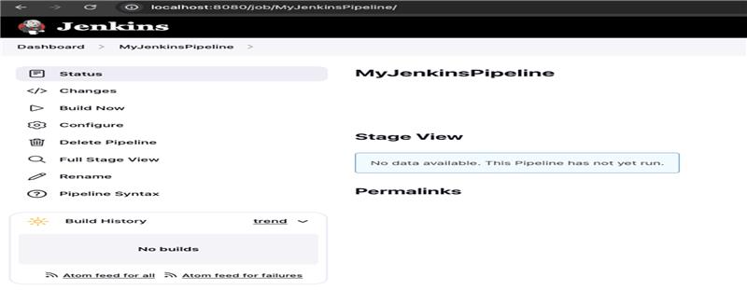
Step 20:Trigger the pipeline manually

Slide 51
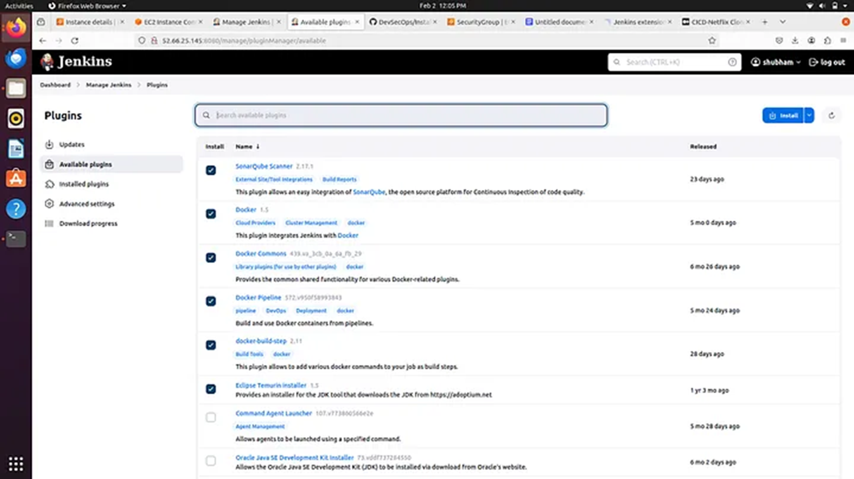
Step 22

Slide 52
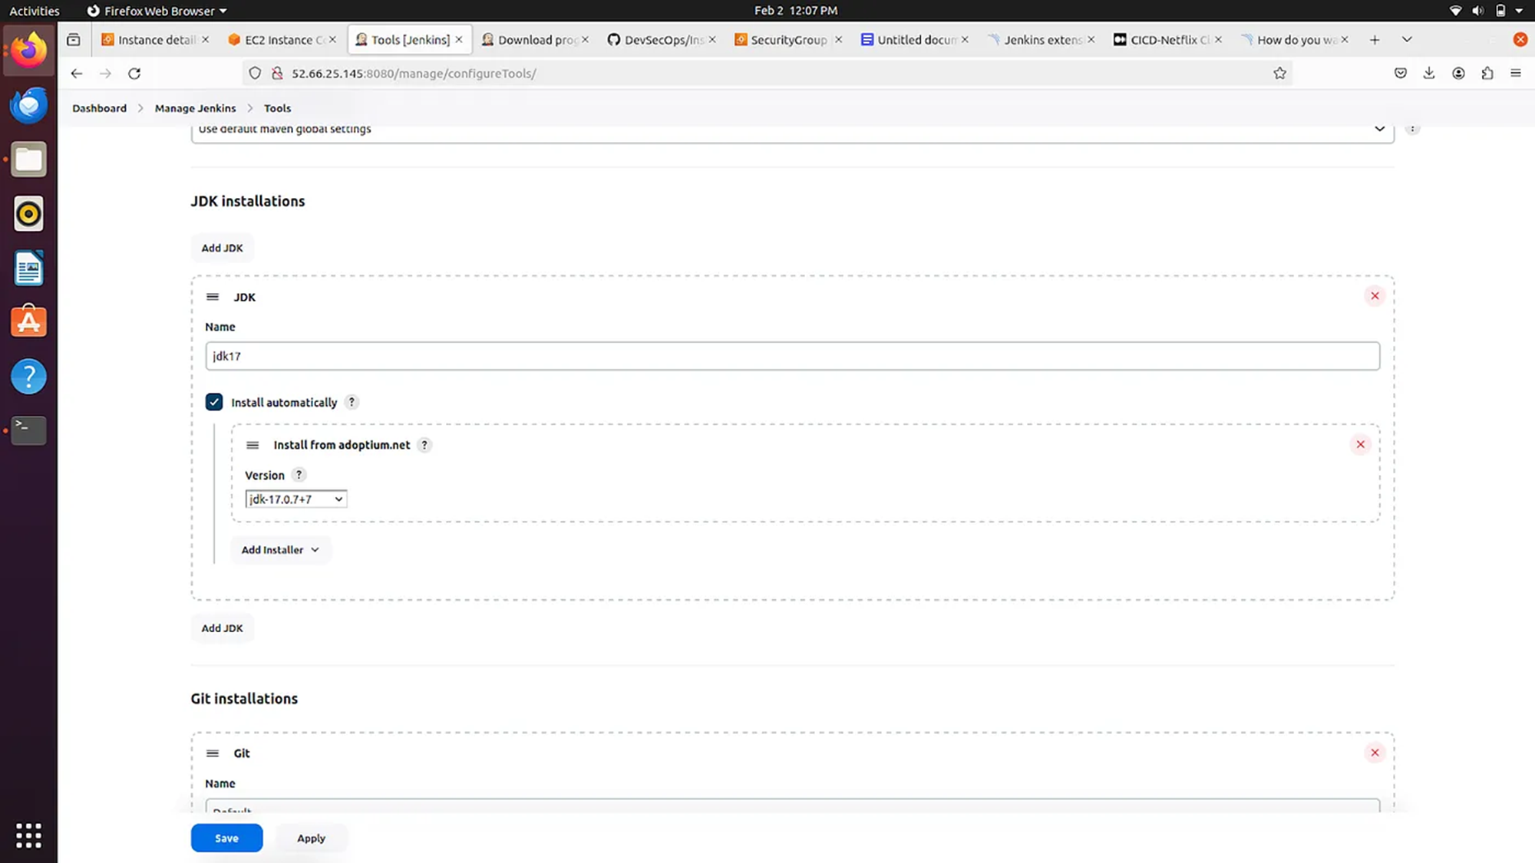
Step 23

Slide 53
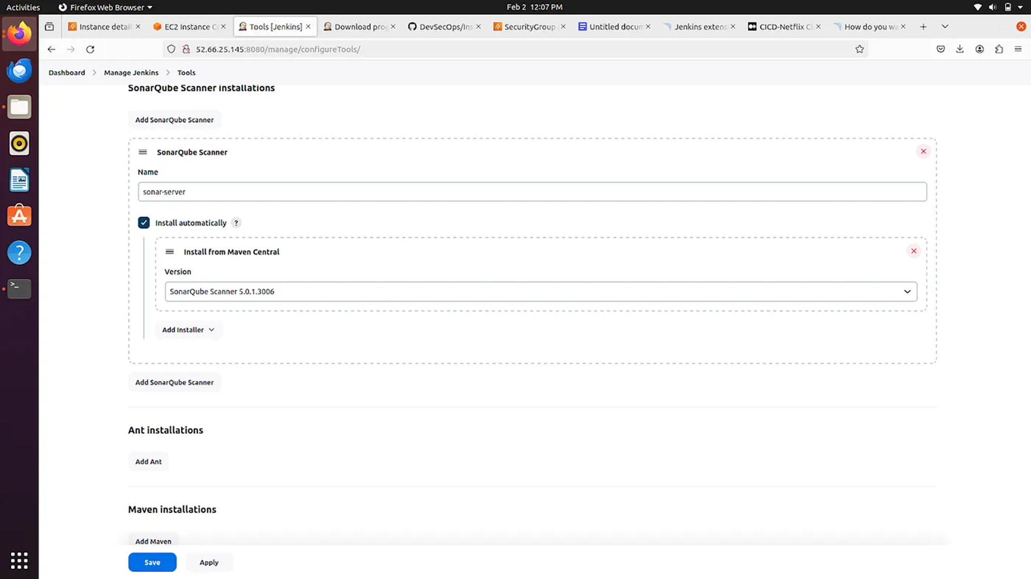
Step 24

Slide 54
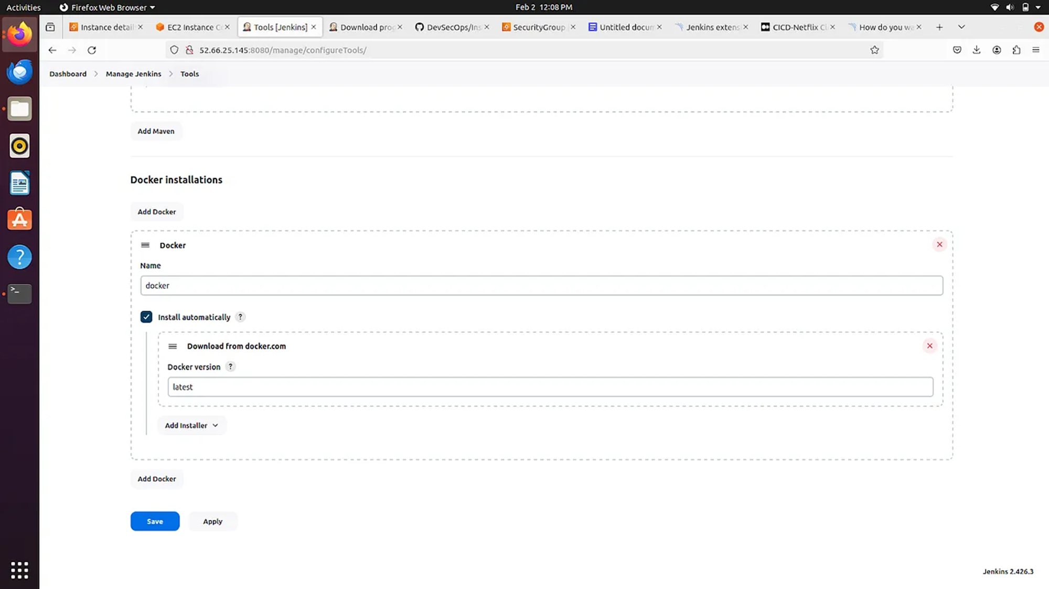
Step 25

Slide 55
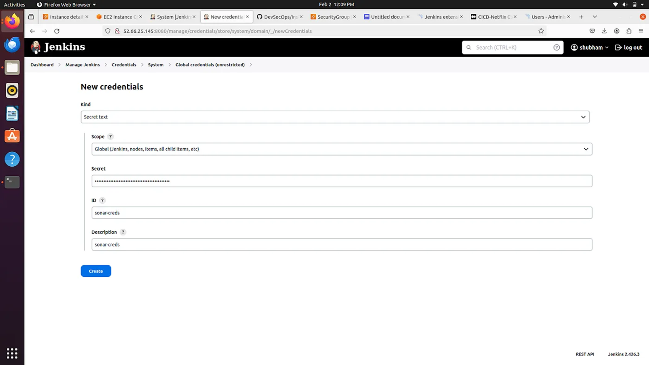
Step 26

Slide 56
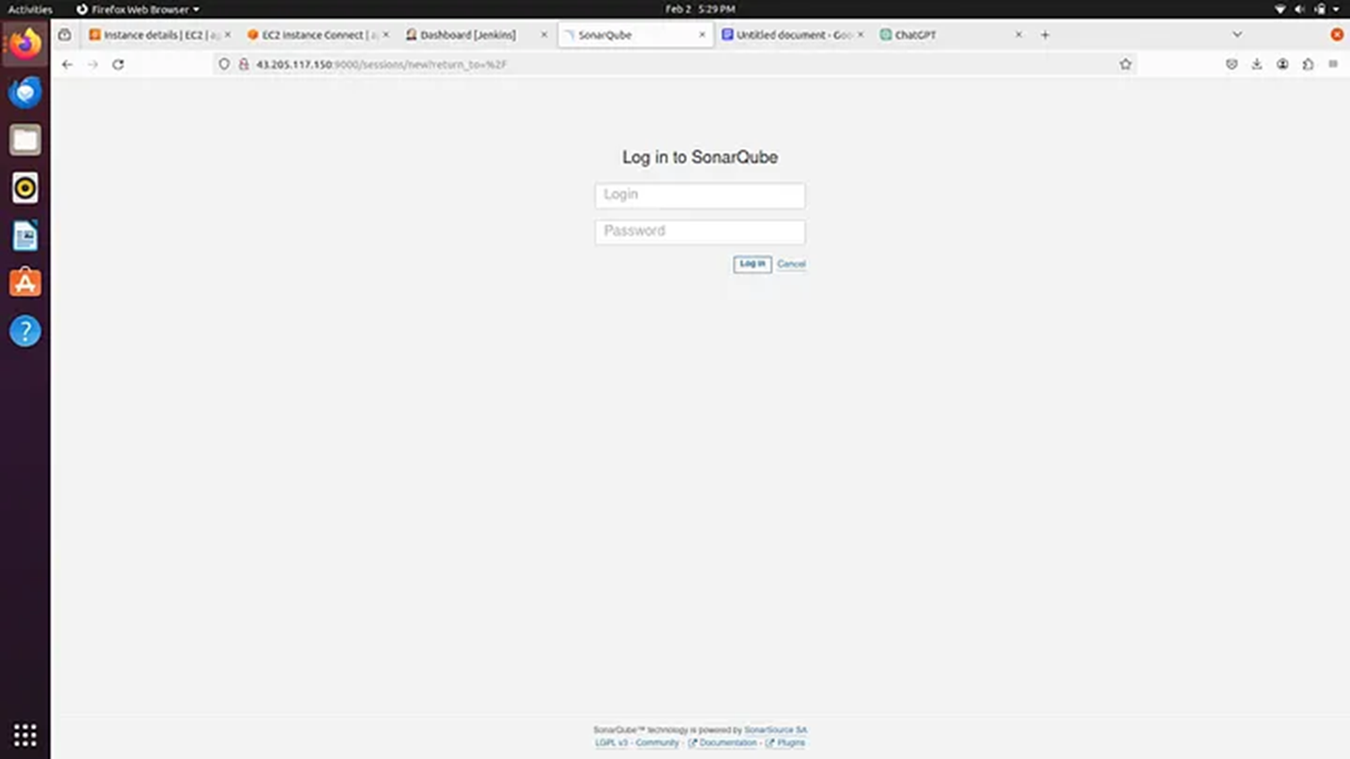
Step 27:SonarQube Dashboard

Slide 57
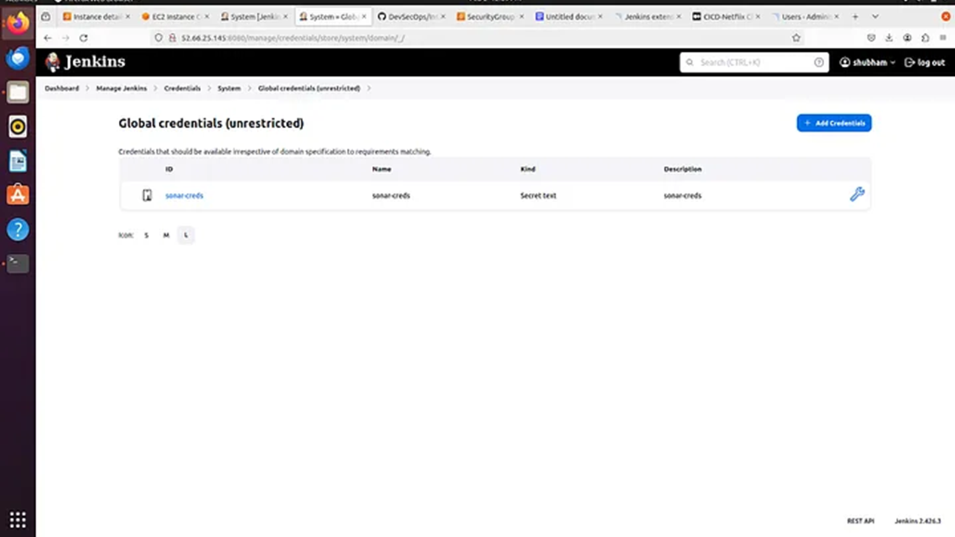
Step 28

Slide 58
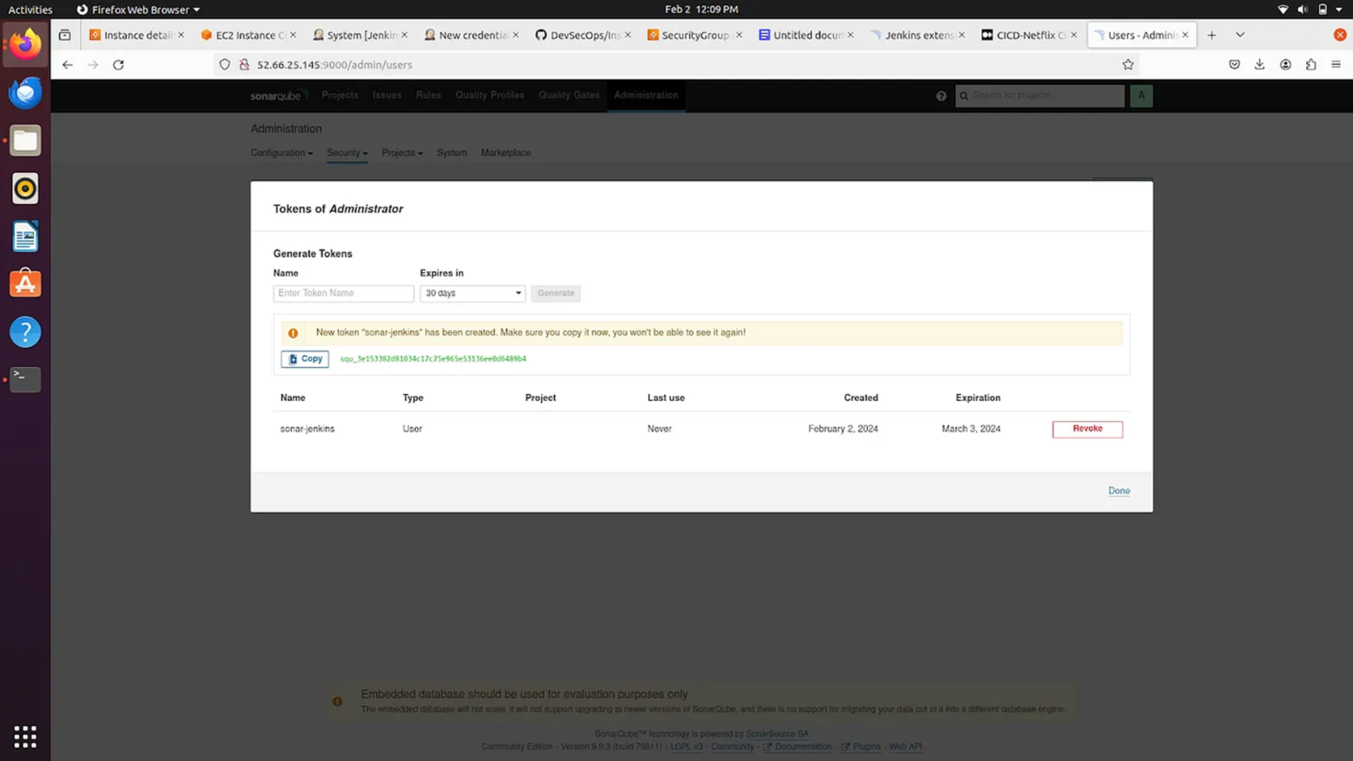
Step 29

Slide 59
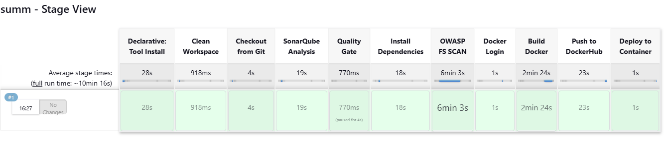
Step 30

Slide 60
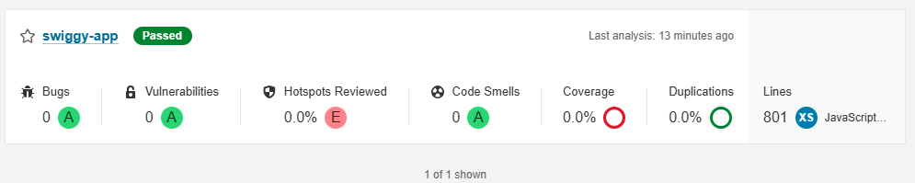
Step 31

Slide 61
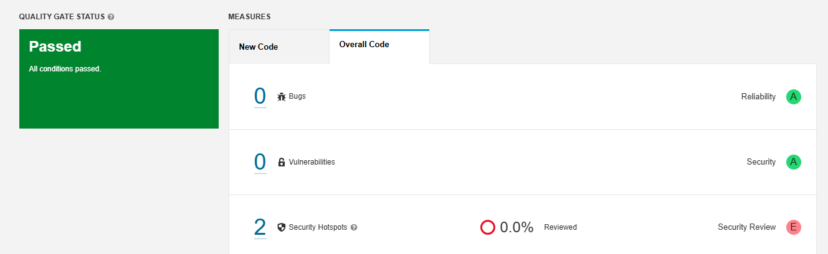
Step 32

Slide 62
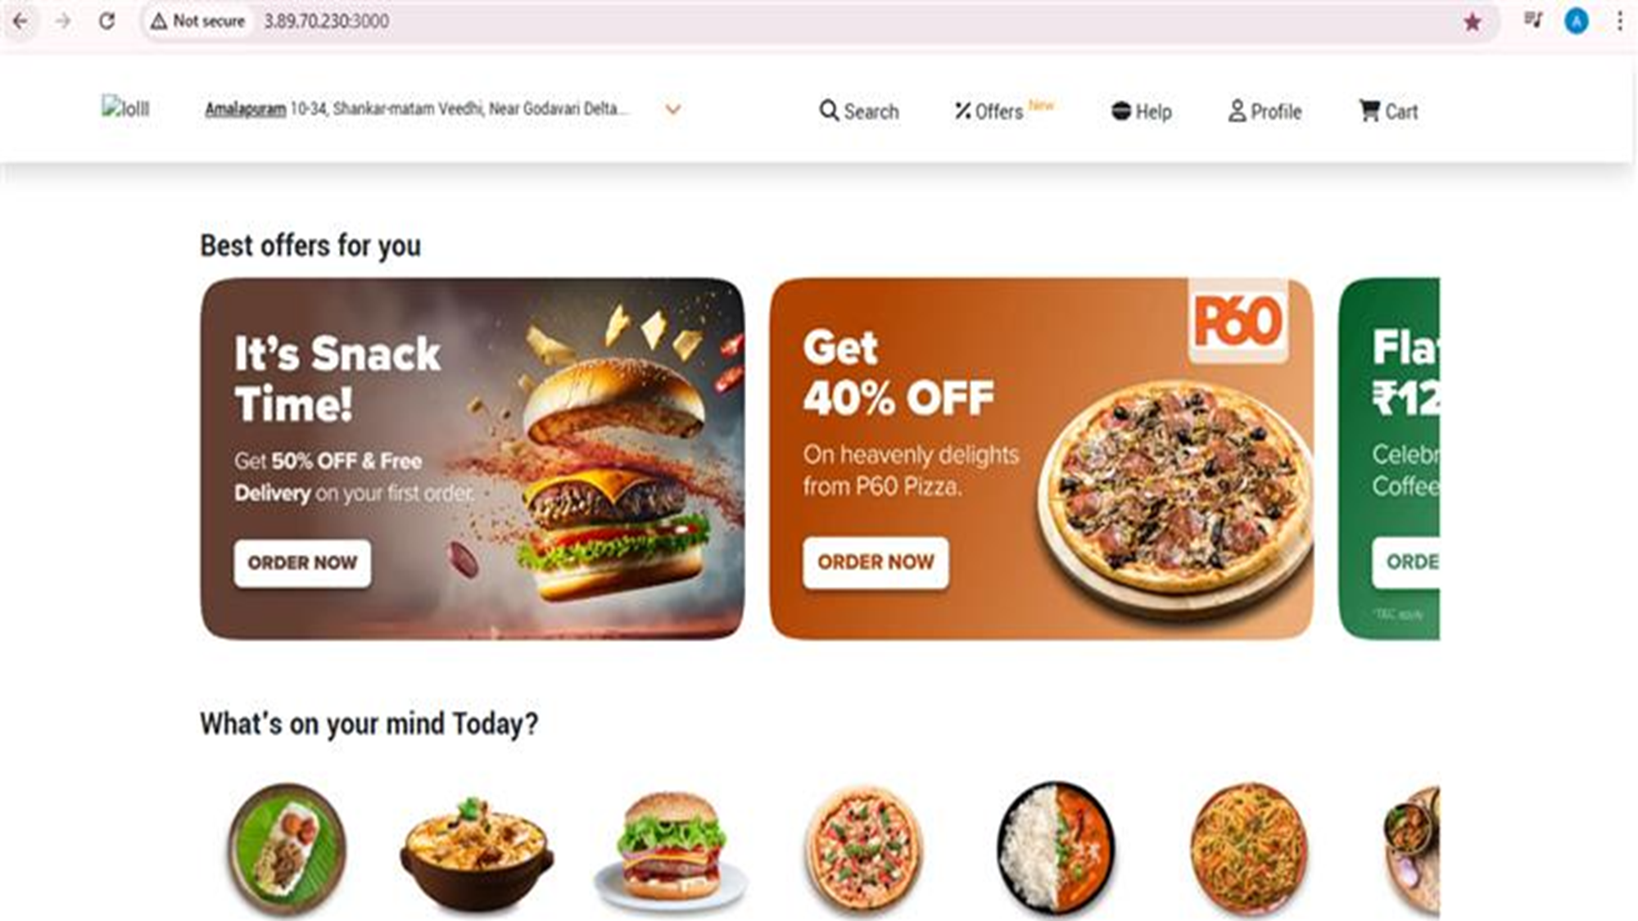
Final Output

